Slide 1

Notes:
Lecture slides prepared for “Computer Security: Principles and Practice”, 3/e, by William Stallings and Lawrie Brown, Chapter 24 “Wireless Network Security”.

Slide 2

Chapter 24
Wireless Network Security
Notes:
Wireless networks and communication links have become pervasive for both
personal
and organizational communications. A wide variety of technologies and
network types have been adopted, including Wi-Fi, Bluetooth, WiMAX, ZigBee,
and cellular technologies. Although the security threats and countermeasures
discussed
throughout this book apply to wireless networks and communications
links, there are some unique aspects to the wireless environment.
This chapter begins with a general overview of wireless security issues. We
then focus on the relatively new area of mobile device security, examining threats
and countermeasures for mobile devices used in the enterprise. Then, we look
at the IEEE 802.11i standard for wireless LAN security. This standard is part of
IEEE 802.11, also referred to as Wi-Fi. We begin the discussion with an overview of
IEEE 802.11, and then we look in some detail at IEEE 802.11i.

Slide 3
Wireless Security
Key factors contributing to higher security risk of wireless networks compared to wired networks include:
Channel
Wireless networking typically involves broadcast communications, which is far more susceptible to eavesdropping and jamming than wired networks
Wireless networks are also more vulnerable to active attacks that exploit vulnerabilities in communications protocols
Mobility
Wireless devices are far more portable and mobile, thus resulting in a number of risks
Resources
Some wireless devices, such as smartphones and tablets, have sophisticated operating systems but limited memory and processing resources with which to counter threats, including denial of service and malware
Accessibility
Some wireless devices, such as sensors and robots, may be left unattended in remote and/or hostile locations, thus greatly increasing their vulnerability to physical attacks
Notes:
Wireless networks, and the wireless devices that use them, introduce a host of security
problems over and above those found in wired networks. Some of the key factors
contributing to the higher security risk of wireless networks compared to wired
networks include the following [MA10]:
• Channel: Wireless networking typically involves broadcast communications,
which is far more susceptible to eavesdropping and jamming than wired networks.
Wireless networks are also more vulnerable to active attacks that
exploit vulnerabilities in communications protocols.
• Mobility: Wireless devices are, in principal and usually in practice, far more
portable and mobile than wired devices. This mobility results in a number of
risks, described subsequently.
• Resources: Some wireless devices, such as smartphones and tablets, have
sophisticated operating systems but limited memory and processing resources
with which to counter threats, including denial of service and malware.
• Accessibility: Some wireless devices, such as sensors and robots, may be left
unattended in remote and/or hostile locations. This greatly increases their vulnerability
to physical attacks.

Slide 4
Notes:
In simple terms, the wireless environment consists of three components that
provide point of attack ( Figure 24.1 ). The wireless client can be a cell phone, a
Wi-Fi enabled laptop or tablet, a wireless sensor, a Bluetooth device, and so on.
The wireless access point provides a connection to the network or service. Examples
of access points are cell towers, Wi-Fi hot spots, and wireless access points to wired
local or wide-area networks. The transmission medium, which carries the radio
waves for data transfer, is also a source of vulnerability.

Slide 5
Wireless Network Threats
Accidental association
Malicious association
Ad hoc networks
Nontraditional networks
Identity theft (MAC spoofing)
Man-in-the middle attacks
Denial of service (DoS)
Network injection
Notes:
[CHOI08] lists the following security threats to wireless networks:
• Accidental association: Company wireless LANs or wireless access points to
wired LANs in close proximity (e.g., in the same or neighboring buildings) may
create overlapping transmission ranges. A user intending to connect to one
LAN may unintentionally lock on to a wireless access point from a neighboring
network. Although the security breach is accidental, it nevertheless exposes
resources of one LAN to the accidental user.
• Malicious association: In this situation, a wireless device is configured to
appear to be a legitimate access point, enabling the operator to steal passwords
from legitimate users and then penetrate a wired network through a legitimate
wireless access point.
• Ad hoc networks: These are peer-to-peer networks between wireless
computers with no access point between them. Such networks can pose a
security threat due to a lack of a central point of control.
• Nontraditional networks: Nontraditional networks and links, such as personal
network Bluetooth devices, barcode readers, and handheld PDAs pose a
security risk both in terms of eavesdropping and spoofing.
• Identity theft (MAC spoofing): This occurs when an attacker is able to
eavesdrop on network traffic and identify the MAC address of a computer
with network privileges.
• Man-in-the middle attacks: This type of attack is described in Chapter 21 in
the context of the Diffie-Hellman key exchange protocol. In a broader sense,
this attack involves persuading a user and an access point to believe that they
are talking to each other when in fact the communication is going through an
intermediate attacking device. Wireless networks are particularly vulnerable
to such attacks.
• Denial of service (DoS): This type of attack was discussed in detail in
Chapter 7 . In the context of a wireless network, a DoS attack occurs when an
attacker continually bombards a wireless access point or some other accessible
wireless port with various protocol messages designed to consume
system resources. The wireless environment lends itself to this type of attack,
because it is so easy for the attacker to direct multiple wireless messages at
the target.
• Network injection: A network injection attack targets wireless access points
that are exposed to non-filtered network traffic, such as routing protocol
messages or network management messages. An example of such an attack is
one in which bogus reconfiguration commands are used to affect routers and
switches to degrade network performance.

Slide 6
Securing Wireless Transmissions
Principal threats are eavesdropping, altering or inserting messages, and disruption
Countermeasures for eavesdropping:
Signal-hiding techniques
Encryption
The use of encryption and authentication protocols is the standard method of countering attempts to alter or insert transmissions
Notes:
Following [CHOI08], we can group wireless security measures into those dealing
with wireless transmissions, wireless access points, and wireless networks (consisting
of wireless routers and endpoints).
The principal threats to wireless transmission
are eavesdropping, altering or inserting messages, and disruption. To deal with
eavesdropping, two types of countermeasures are appropriate:
• Signal-hiding techniques: Organizations can take a number of measures to
make it more difficult for an attacker to locate their wireless access points,
including turning off service set identifier (SSID) broadcasting by wireless
access points; assigning cryptic names to SSIDs; reducing signal strength to the
lowest level that still provides requisite coverage; and locating wireless access
points in the interior of the building, away from windows and exterior walls.
Greater security can be achieved by the use of directional antennas and of
signal-shielding techniques.
• Encryption: Encryption of all wireless transmission is effective against
eavesdropping to the extent that the encryption keys are secured.
The use of encryption and authentication protocols is the standard method of
countering attempts to alter or insert transmissions.
The methods discussed in Chapter 7 for dealing with denial of service apply
to wireless transmissions. Organizations can also reduce the risk of unintentional
DoS attacks. Site surveys can detect the existence of other devices using the same
frequency range, to help determine where to locate wireless access points. Signal
strengths can be adjusted and shielding used in an attempt to isolate a wireless
environment from competing nearby transmissions.

Slide 7
Securing Wireless Networks
The main threat involving wireless access points is unauthorized access to the network
Principal approach for preventing such access is the IEEE 802.1X standard for port-based network access control
The standard provides an authentication mechanism for devices wishing to attach to a LAN or wireless network
Use of 802.1X can prevent rogue access points and other unauthorized devices from becoming insecure backdoors
Notes:
The main threat involving wireless access
points is unauthorized access to the network. The principal approach for preventing
such access is the IEEE 802.1X standard for port-based network access control. The
standard provides an authentication mechanism for devices wishing to attach to a
LAN or wireless network. The use of 802.1X can prevent rogue access points and
other unauthorized devices from becoming insecure backdoors.

Slide 8

Wireless Network Security Techniques
Use encryption
Use anti-virus and anti-spyware software and a firewall
Turn off identifier broadcasting
Change the identifier on your router from the default
Change your router’s pre-set password for administration
Allow only specific computers to access your wireless network
Notes:
[CHOI08] recommends the following techniques
for wireless network security:
1. Use encryption. Wireless routers are typically equipped with built-in
encryption mechanisms for router-to-router traffic.
2. Use anti-virus and anti-spyware software, and a firewall. These facilities
should be enabled on all wireless network endpoints.
3. Turn off identifier broadcasting. Wireless routers are typically configured to
broadcast an identifying signal so that any device within range can learn of
the router’s existence. If a network is configured so that authorized devices
know the identity of routers, this capability can be disabled, so as to thwart
attackers.
4. Change the identifier on your router from the default. Again, this measure
thwarts attackers who will attempt to gain access to a wireless network using
default router identifiers.
5. Change your router’s pre-set password for administration. This is another
prudent step.
6. Allow only specific computers to access your wireless network. A router
can be configured to only communicate with approved MAC addresses.
Of course, MAC addresses can be spoofed, so this is just one element of a
security strategy.

Slide 9
Mobile Device Security
An organization’s networks must accommodate:
Growing use of new devices
Significant growth in employee’s use of mobile devices
Cloud-based applications
Applications no longer run solely on physical servers in corporate data centers
De-perimeterization
There are a multitude of network perimeters around devices, applications, users, and data
External business requirements
The enterprise must also provide guests, third-party contractors, and business partners network access using various devices from a multitude of locations
Notes:
Prior to the widespread use of smartphones, the dominant paradigm for computer
and network security in organizations was as follows. Corporate IT was tightly controlled.
User devices were typically limited to Windows PCs. Business applications
were controlled by IT and either run locally on endpoints or on physical servers
in data centers. Network security was based upon clearly defined perimeters that
separated trusted internal networks from the untrusted Internet. Today, there have
been massive changes in each of these assumptions. An organization’s networks
must accommodate the following:
• Growing use of new devices: Organizations are experiencing significant growth
in employee’s use of mobile devices. In many cases, employees are allowed to
use a combination of endpoint devices as part of their day-to-day activities.
• Cloud-based applications: Applications no longer run solely on physical
servers in corporate data centers. Quite the opposite, applications can run
anywhere—on traditional physical servers, on mobile virtual servers, or in the
cloud. Additionally, end users can now take advantage of a wide variety of
cloud-based applications and IT services for personal and professional use.
Facebook can be used for an employee’s personal profile or as a component
of a corporate marketing campaign. Employees depend upon Skype to speak
with friends abroad or for legitimate business video conferencing. Dropbox
and Box can be used to distribute documents between corporate and personal
devices for mobility and user productivity.
• De-perimeterization: Given new device proliferation, application mobility,
and cloud-based consumer and corporate services, the notion of a static network
perimeter is all but gone. Now there are a multitude of network perimeters
around devices, applications, users, and data. These perimeters have also
become quite dynamic as they must adapt to various environmental conditions
such as user role, device type, server virtualization mobility, network location,
and time-of-day.
• External business requirements: The enterprise must also provide guests,
third-party contractors, and business partners network access using various
devices from a multitude of locations.
The central element in all of these changes is the mobile computing device.
Mobile devices have become an essential element for organizations as part of the
overall network infrastructure. Mobile devices such as smartphones, tablets, and
memory sticks provide increased convenience for individuals as well as the potential
for increased productivity in the workplace. Because of their widespread use and
unique characteristics, security for mobile devices is a pressing and complex issue.
In essence, an organization needs to implement a security policy through a combination
of security features built into the mobile devices and additional security controls
provided by network components that regulate the use of the mobile devices.

Slide 10
Security Threats
Lack of physical security controls
Use of untrusted networks
Use of untrusted mobile devices
Use of applications created by unknown parties
Interaction with other systems
Use of untrusted content
Use of location services
Notes:
If a mobile device is used on premises, it can
connect to organization resources over the organization’s own in-house wireless
networks. However, for off-premises use, the user will typically access organizational
resources via Wi-Fi or cellular access to the Internet and from the Internet to the
organization. Thus, traffic that includes an off-premises segment is potentially
susceptible to eavesdropping or man-in-the-middle types of attacks. Thus, the
security policy must be based on the assumption that the networks between the
mobile device and the organization are not trustworthy.
Use of Applications Created by Unknown Parties By design, it is easy to find
and install third-party applications on mobile devices. This poses the obvious risk of
installing malicious software. An organization has several options for dealing with
this threat, as described subsequently.
Interaction with other Systems A common feature found on smartphones
and tablets is the ability to automatically synchronize data, apps, contacts, photos,
and so on with other computing devices and with cloud-based storage. Unless an
organization has control of all the devices involved in synchronization, there is
considerable risk of the organization’s data being stored in an unsecured location,
plus the risk of the introduction of malware.
Use of Untrusted Content Mobile devices may access and use content that other
computing devices do not encounter. An example is the Quick Response (QR) code,
which is a two-dimensional barcode. QR codes are designed to be captured by a mobile
device camera and used by the mobile device. The QR code translates to a URL, so
that a malicious QR code could direct the mobile device to malicious Web sites.
Use of Location Services The GPS capability on mobile devices can be used
to maintain a knowledge of the physical location of the device. While this feature
might be useful to an organization as part of a presence service, it creates security
risks. An attacker can use the location information to determine where the device
and user are located, which may be of use to the attacker.
Mobile Device Security Strategy
With the threats listed in the preceding discussion in mind, we outline the principal
elements of a mobile device security strategy. They fall into three categories: device
security, client/server traffic security, and barrier security (Figure 24.2).
Device Security A number of organizations will supply mobile devices for
employee use and pre-configure those devices to conform to the enterprise security
policy. However, many organizations will find it convenient or even necessary to
adopt a bring-your-own-device (BYOD) policy that allows the personal mobile
devices of employees to have access to corporate resources. IT managers should be
able to inspect each device before allowing network access. IT will want to establish
configuration guidelines for operating systems and applications.

Slide 11
Notes:
With the threats listed in the preceding discussion in mind, we outline the principal
elements of a mobile device security strategy. They fall into three categories: device
security, client/server traffic security, and barrier security (Figure 24.2).

Slide 12
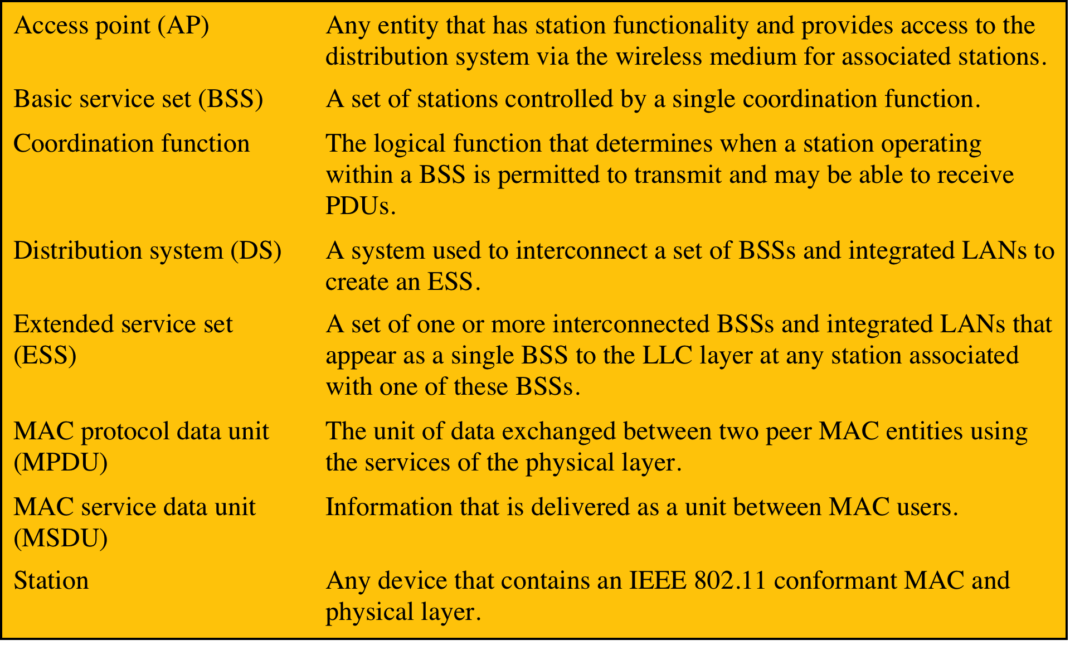
Table 24.1 IEEE 802.11 Terminology
Notes:
IEEE 802 is a committee that has developed standards for a wide range of local area
networks (LANs). In 1990, the IEEE 802 Committee formed a new working group,
IEEE 802.11, with a charter to develop a protocol and transmission specifications
for wireless LANs (WLANs). Since that time, the demand for WLANs at different
frequencies and data rates has exploded. Keeping pace with this demand, the IEEE
802.11 working group has issued an ever-expanding list of standards. Table 24.1
briefly defines key terms used in the IEEE 802.11 standard.

Slide 13
Wireless Fidelity (Wi-Fi) Alliance
802.11b
First 802.11 standard to gain broad industry acceptance
Wireless Ethernet Compatibility Alliance (WECA)
Industry consortium formed in 1999 to address the concern of products from different vendors successfully interoperating
Later renamed the Wi-Fi Alliance
Term used for certified 802.11b products is Wi-Fi
Has been extended to 802.11g products
Wi-Fi Protected Access (WPA)
Wi-Fi Alliance certification procedures for IEEE802.11 security standards
WPA2 incorporates all of the features of the IEEE802.11i WLAN security specification
Notes:
The first 802.11 standard to gain broad industry acceptance was 802.11b. Although
802.11b products are all based on the same standard, there is always a concern
whether products from different vendors will successfully interoperate. To meet
this concern, the Wireless Ethernet Compatibility Alliance (WECA), an industry
consortium, was formed in 1999. This organization, subsequently renamed the
Wi-Fi (Wireless Fidelity) Alliance, created a test suite to certify interoperability
for 802.11b products. The term used for certified 802.11b products is Wi-Fi . Wi-Fi
certification has been extended to 802.11g products. The Wi-Fi Alliance has also
developed a certification process for 802.11a products, called Wi-Fi5 . The Wi-Fi
Alliance is concerned with a range of market areas for WLANs, including enterprise,
home, and hot spots.
More recently, the Wi-Fi Alliance has developed certification procedures for
IEEE 802.11 security standards, referred to as Wi-Fi Protected Access (WPA). The
most recent version of WPA, known as WPA2, incorporates all of the features of
the IEEE 802.11i WLAN security specification.

Slide 14
Notes:
Before proceeding, we need to briefly preview the IEEE 802 protocol architecture.
IEEE 802.11 standards are defined within the structure of a layered set
of protocols. This structure, used for all IEEE 802 standards, is illustrated in
Figure 24.3 .
The lowest layer of the IEEE 802 reference model is the
physical layer , which includes such functions as encoding/decoding of signals and
bit transmission/reception. In addition, the physical layer includes a specification of
the transmission medium. In the case of IEEE 802.11, the physical layer also defines
frequency bands and antenna characteristics.
Medium Access Control All LANs consist of collections of devices that share
the network’s transmission capacity. Some means of controlling access to the
transmission medium is needed to provide an orderly and efficient use of that
capacity. This is the function of a medium access control (MAC) layer. The MAC
layer receives data from a higher-layer protocol, typically the logical link control
(LLC) layer, in the form of a block of data known as the MAC service data unit
(MSDU) . In general, the MAC layer performs the following functions:
• On transmission, assemble data into a frame, known as a MAC protocol data
unit (MPDU) with address and error-detection fields.
• On reception, disassemble frame, and perform address recognition and error
detection.
• Govern access to the LAN transmission medium.
In most data-link control protocols, the data-link
protocol entity is responsible not only for detecting errors using the CRC, but
for recovering from those errors by retransmitting damaged frames. In the LAN
protocol architecture, these two functions are split between the MAC and LLC
layers. The MAC layer is responsible for detecting errors and discarding any frames
that contain errors. The LLC layer optionally keeps track of which frames have
been successfully received and retransmits unsuccessful frames.

Slide 15
Notes:
The exact format of the MPDU differs somewhat for the various MAC protocols
in use. In general, all of the MPDUs have a format similar to that of Figure 24.4 .
The fields of this frame are as follows:
• MAC Control: This field contains any protocol control information needed
for the functioning of the MAC protocol. For example, a priority level could
be indicated here.
• Destination MAC Address: The destination physical address on the LAN for
this MPDU.
• Source MAC Address: The source physical address on the LAN for this
MPDU.
• MAC Service Data Unit: The data from the next higher layer.
• CRC: The cyclic redundancy check field, also known as the Frame Check
Sequence (FCS) field. This is an error-detecting code, such as that which is
used in other data-link control protocols. The CRC is calculated based on the
bits in the entire MPDU. The sender calculates the CRC and adds it to the
frame. The receiver performs the same calculation on the incoming MPDU
and compares that calculation to the CRC field in that incoming MPDU. If the
two values don’t match, then one or more bits have been altered in transit.
The fields preceding the MSDU field are referred to as the MAC header , and
the field following the MSDU field is referred to as the MAC trailer . The header
and trailer contain control information that accompany the data field and that are
used by the MAC protocol.

Slide 16
Notes:
Figure 24.5 illustrates the model developed by the 802.11 working group. The
smallest building block of a wireless LAN is a basic service set (BSS) , which consists
of wireless stations executing the same MAC protocol and competing for access to
the same shared wireless medium. A BSS may be isolated or it may connect to a
backbone distribution system (DS) through an access point (AP) . The AP functions
as a bridge and a relay point. In a BSS, client stations do not communicate directly
with one another. Rather, if one station in the BSS wants to communicate with
another station in the same BSS, the MAC frame is first sent from the originating
station to the AP and then from the AP to the destination station. Similarly, a MAC
frame from a station in the BSS to a remote station is sent from the local station to
the AP and then relayed by the AP over the DS on its way to the destination station.
The BSS generally corresponds to what is referred to as a cell in the literature. The
DS can be a switch, a wired network, or a wireless network.
When all the stations in the BSS are mobile stations that communicate directly
with one another (not using an AP) the BSS is called an independent BSS (IBSS) .
An IBSS is typically an ad hoc network. In an IBSS, the stations all communicate
directly, and no AP is involved.
A simple configuration is shown in Figure 24.5 , in which each station belongs
to a single BSS; that is, each station is within wireless range only of other stations
within the same BSS. It is also possible for two BSSs to overlap geographically,
so that a single station could participate in more than one BSS. Furthermore, the
association between a station and a BSS is dynamic. Stations may turn off, come
within range, and go out of range.
An extended service set (ESS) consists of two or more basic service sets
interconnected by a distribution system. The extended service set appears as a
single logical LAN to the LLC level.

Slide 17
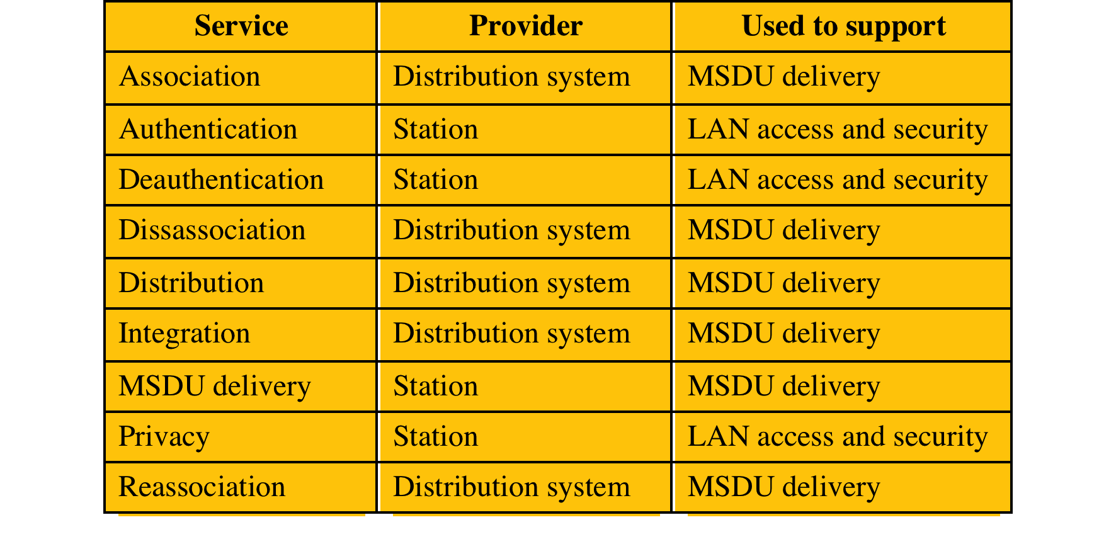
Table 24.2 IEEE 802.11 Services
Notes:
IEEE 802.11 defines nine services that need to be provided by the wireless LAN to
achieve functionality equivalent to that which is inherent to wired LANs. Table 24.2
lists the services and indicates two ways of categorizing them.
1. The service provider can be either the station or the DS. Station services
are implemented in every 802.11 station, including AP stations. Distribution
services are provided between BSSs; these services may be implemented in an
AP or in another special-purpose device attached to the distribution system.
2. Three of the services are used to control IEEE 802.11 LAN access and
confidentiality. Six of the services are used to support delivery of MSDUs
between stations. If the MSDU is too large to be transmitted in a single
MPDU, it may be fragmented and transmitted in a series of MPDUs.
Following the IEEE 802.11 document, we next discuss the services in an order
designed to clarify the operation of an IEEE 802.11 ESS network. MSDU delivery ,
which is the basic service, has already been mentioned. Services related to security
are introduced in Section 24.3 .

Slide 18
Distribution of Messages Within a DS
The two services involved with the distribution of messages within a DS are:
Distribution
Integration
Distribution
The primary service used by stations to exchange MPDUs when the MPDUs must traverse the DS to get from a station in one BSS to a station in another BSS
Integration
Enables transfer of data between a station on an IEEE 802.11 LAN and a station on an integrated IEEE 802x LAN
Service enables transfer of data between a station on an IEEE 802.11 LAN and a station on an integrated IEEE 802.x LAN
Notes:
The two services involved with the
distribution of messages within a DS are distribution and integration. Distribution
is the primary service used by stations to exchange MPDUs when the MPDUs must
traverse the DS to get from a station in one BSS to a station in another BSS. For
example, suppose a frame is to be sent from station 2 (STA 2) to station 7 (STA 7)
in Figure 24.5 . The frame is sent from STA 2 to AP 1, which is the AP for this BSS.
The AP gives the frame to the DS, which has the job of directing the frame to the
AP associated with STA 7 in the target BSS. AP 2 receives the frame and forwards
it to STA 7. How the message is transported through the DS is beyond the scope of
the IEEE 802.11 standard.
If the two stations that are communicating are within the same BSS, then the
distribution service logically goes through the single AP of that BSS.
The integration service enables transfer of data between a station on an IEEE
802.11 LAN and a station on an integrated IEEE 802.x LAN. The term integrated
refers to a wired LAN that is physically connected to the DS and whose stations
may be logically connected to an IEEE 802.11 LAN via the integration service. The
integration service takes care of any address translation and media conversion logic
required for the exchange of data.

Slide 19
Association-Related Services
Transition types, based on mobility:
No transition
A station of this type is either stationary or moves only within the direct communication range of the communicating stations of a single BSS
BSS transition
Station movement from one BSS to another BSS within the same ESS; delivery of data to the station requires that the addressing capability be able to recognize the new location of the station
ESS transition
Station movement from a BSS in one ESS to a BSS within another ESS; maintenance of upper-layer connections supported by 802.11 cannot be guaranteed
Notes:
The primary purpose of the MAC layer is to
transfer MSDUs between MAC entities; this purpose is fulfilled by the distribution
service. For that service to function, it requires information about stations within
the ESS that is provided by the association-related services. Before the distribution
service can deliver data to or accept data from a station, that station must be
associated . Before looking at the concept of association, we need to describe the
concept of mobility. The standard defines three transition types, based on mobility:
• No transition: A station of this type is either stationary or moves only within
the direct communication range of the communicating stations of a single BSS.
• BSS transition: This is defined as a station movement from one BSS to
another BSS within the same ESS. In this case, delivery of data to the station
requires that the addressing capability be able to recognize the new location
of the station.
• ESS transition: This is defined as a station movement from a BSS in one ESS
to a BSS within another ESS. This case is supported only in the sense that
the station can move. Maintenance of upper-layer connections supported
by 802.11 cannot be guaranteed. In fact, disruption of service is likely to
occur.

Slide 20
Services
Association
Establishes an initial association between a station and an AP
Reassociation
Enables an established association to be transferred from one AP to another, allowing a mobile station to move from one BSS to another
Disassociation
A notification from either a station or an AP that an existing association is terminated
Notes:
To deliver a message within a DS, the distribution service needs to know where
the destination station is located. Specifically, the DS needs to know the identity of
the AP to which the message should be delivered in order for that message to reach
the destination station. To meet this requirement, a station must maintain an association
with the AP within its current BSS. Three services relate to this requirement:
• Association: Establishes an initial association between a station and an AP.
Before a station can transmit or receive frames on a wireless LAN, its identity
and address must be known. For this purpose, a station must establish an
association with an AP within a particular BSS. The AP can then communicate
this information to other APs within the ESS to facilitate routing and delivery
of addressed frames.
• Reassociation: Enables an established association to be transferred from one
AP to another, allowing a mobile station to move from one BSS to another.
• Disassociation: A notification from either a station or an AP that an existing
association is terminated. A station should give this notification before leaving
an ESS or shutting down. However, the MAC management facility protects
itself against stations that disappear without notification.

Slide 21
Wireless LAN Security
Wired Equivalent Privacy (WEP) algorithm
802.11 privacy
Wi-Fi Protected Access (WPA)
Set of security mechanisms that eliminates most 802.11 security issues and was based on the current state of the 802.11i standard
Robust Security Network (RSN)
Final form of the 802.11i standard
Wi-Fi Alliance certifies vendors in compliance with the full 802.11i specification under the WPA2 program
Notes:
There are two characteristics of a wired LAN that are not inherent in a wireless
LAN.
1. In order to transmit over a wired LAN, a station must be physically connected
to the LAN. On the other hand, with a wireless LAN, any station within radio
range of the other devices on the LAN can transmit. In a sense, there is a
form of authentication with a wired LAN in that it requires some positive and
presumably observable action to connect a station to a wired LAN.
2. Similarly, in order to receive a transmission from a station that is part of a
wired LAN, the receiving station also must be attached to the wired LAN.
On the other hand, with a wireless LAN, any station within radio range can
receive. Thus, a wired LAN provides a degree of privacy, limiting reception of
data to stations connected to the LAN.
These differences between wired and wireless LANs suggest the increased
need for robust security services and mechanisms for wireless LANs. The
original 802.11 specification included a set of security features for privacy and
authentication that were quite weak. For privacy, 802.11 defined the Wired
Equivalent Privacy (WEP) algorithm. The privacy portion of the 802.11
standard contained major weaknesses. Subsequent to the development of WEP,
the 802.11i task group has developed a set of capabilities to address the WLAN
security issues. In order to accelerate the introduction of strong security into
WLANs, the Wi-Fi Alliance promulgated Wi-Fi Protected Access (WPA) as a
Wi-Fi standard. WPA is a set of security mechanisms that eliminates most 802.11
security issues and was based on the current state of the 802.11i standard. The
final form of the 802.11i standard is referred to as Robust Security Network
(RSN) . The Wi-Fi Alliance certifies vendors in compliance with the full 802.11i
specification under the WPA2 program.

Slide 22
Notes:
The 802.11i RSN security specification defines the following services.
• Authentication: A protocol is used to define an exchange between a user and an
AS (authentication server) that provides mutual authentication and generates
temporary keys to be used between the client and the AP over the wireless link.
• Access control: This function enforces the use of the authentication function,
routes the messages properly, and facilitates key exchange. It can work with a
variety of authentication protocols.
• Privacy with message integrity: MAC-level data (e.g., an LLC PDU) are
encrypted along with a message integrity code that ensures that the data have
not been altered.
Figure 24.6a indicates the security protocols used to support these services,
while Figure 24.6b lists the cryptographic algorithms used for these services.

Slide 23
Notes:
The operation of an IEEE 802.11i RSN can be broken down into five distinct
phases. The exact nature of the phases will depend on the configuration and the end
points of the communication. Possibilities include (see Figure 24.5 ):
1. Two wireless stations in the same BSS communicating via the access point for
that BSS.
2. Two wireless stations (STAs) in the same ad hoc IBSS communicating directly
with each other.
3. Two wireless stations in different BSSs communicating via their respective
APs across a distribution system.
4. A wireless station communicating with an end station on a wired network via
its AP and the distribution system.
IEEE 802.11i security is concerned only with secure communication between
the STA and its AP. In case 1 in the preceding list, secure communication is assured
if each STA establishes secure communications with the AP. Case 2 is similar,
with the AP functionality residing in the STA. For case 3, security is not provided
across the distribution system at the level of IEEE 802.11, but only within each BSS.
End-to-end security (if required) must be provided at a higher layer. Similarly, in
case 4, security is only provided between the STA and its AP.
With these considerations in mind, Figure 24.7 depicts the five phases of
operation for an RSN and maps them to the network components involved. One
new component is the authentication server (AS). The rectangles indicate the
exchange of sequences of MPDUs. The five phases are defined as follows:
• Discovery: An AP uses messages called Beacons and Probe Responses to
advertise its IEEE 802.11i security policy. The STA uses these to identify an
AP for a WLAN with which it wishes to communicate. The STA associates
with the AP, which it uses to select the cipher suite and authentication
mechanism when the Beacons and Probe Responses present a choice.
• Authentication: During this phase, the STA and AS prove their identities to each
other. The AP blocks non-authentication traffic between the STA and AS until
the authentication transaction is successful. The AP does not participate in the
authentication transaction other than forwarding traffic between the STA and AS.
• Key generation and distribution: The AP and the STA perform several operations
that cause cryptographic keys to be generated and placed on the AP and
the STA. Frames are exchanged between the AP and STA only.
• Protected data transfer: Frames are exchanged between the STA and the end
station through the AP. As denoted by the shading and the encryption module
icon, secure data transfer occurs between the STA and the AP only; security is
not provided end-to-end.
• Connection termination: The AP and STA exchange frames. During this
phase, the secure connection is torn down and the connection is restored to
the original state.

Slide 24
Notes:
We now look in more detail at the RSN phases of operation, beginning with the
discovery phase, which is illustrated in the upper portion of Figure 24.8 . The
purpose of this phase is for an STA and an AP to recognize each other, agree on a
set of security capabilities, and establish an association for future communication
using those security capabilities.
During this phase, the STA and AP decide on specific
techniques in the following areas:
• Confidentiality and MPDU integrity protocols for protecting unicast traffic
(traffic only between this STA and AP)
• Authentication method
• Cryptography key management approach
Confidentiality and integrity protocols for protecting multicast/broadcast traffic
are dictated by the AP, since all STAs in a multicast group must use the same
protocols and ciphers. The specification of a protocol, along with the chosen key
length (if variable), is known as a cipher suite . The options for the confidentiality
and integrity cipher suite are:
• WEP, with either a 40-bit or 104-bit key, which allows backward compatibility
with older IEEE 802.11 implementations
• TKIP
• CCMP
• Vendor-specific methods
The other negotiable suite is the authentication and key management (AKM)
suite, which defines (1) the means by which the AP and STA perform mutual
authentication and (2) the means for deriving a root key from which other keys may
be generated. The possible AKM suites are
• IEEE 802.1X
• Pre-shared key (no explicit authentication takes place and mutual authentication
is implied if the STA and AP share a unique secret key)
• Vendor-specific methods
The discovery phase consists of three exchanges.
• Network and security capability discovery: During this exchange, STAs
discover the existence of a network with which to communicate. The AP
either periodically broadcasts its security capabilities (not shown in figure),
indicated by RSN IE (Robust Security Network Information Element), in a
specific channel through the Beacon frame; or responds to a station’s Probe
Request through a Probe Response frame. A wireless station may discover
available access points and corresponding security capabilities by either
passively monitoring the Beacon frames or actively probing every channel.
• Open system authentication: The purpose of this frame sequence, which
provides no security, is simply to maintain backward compatibility with the
IEEE 802.11 state machine, as implemented in existing IEEE 802.11 hardware.
In essence, the two devices (STA and AP) simply exchange identifiers.
• Association: The purpose of this stage is to agree on a set of security
capabilities to be used. The STA then sends an Association Request frame
to the AP. In this frame, the STA specifies one set of matching capabilities
(one authentication and key management suite, one pair-wise cipher suite, and
one group-key cipher suite) from among those advertised by the AP. If there
is no match in capabilities between the AP and the STA, the AP refuses the
Association Request. The STA blocks it too, in case it has associated with a
rogue AP or someone is inserting frames illicitly on its channel. As shown in
Figure 24.8, the IEEE 802.1X controlled ports are blocked, and no user traffic
goes beyond the AP. The concept of blocked ports is explained subsequently.
As was mentioned, the authentication phase enables mutual authentication between
an STA and an authentication server located in the DS. Authentication is designed
to allow only authorized stations to use the network and to provide the STA with
assurance that it is communicating with a legitimate network.

Slide 25
Notes:
IEEE 802.11i makes use of another
standard that was designed to provide access control functions for LANs. The
standard is IEEE 802.1X, Port-Based Network Access Control. The authentication
protocol that is used, the Extensible Authentication Protocol (EAP), is defined in
the IEEE 802.1X standard. IEEE 802.1X uses the terms supplicant , authenticator ,
and authentication server . In the context of an 802.11 WLAN, the first two terms
correspond to the wireless station and the AP. The AS is typically a separate device
on the wired side of the network (i.e., accessible over the DS) but could also reside
directly on the authenticator.
Until the AS authenticates a supplicant (using an authentication protocol),
the authenticator only passes control and authentication messages between the
supplicant and the AS; the 802.1X control channel is unblocked, but the 802.11 data
channel is blocked. Once a supplicant is authenticated and keys are provided, the
authenticator can forward data from the supplicant, subject to predefined access
control limitations for the supplicant to the network. Under these circumstances,
the data channel is unblocked.
As indicated in Figure 24.9, 802.1X uses the concepts of controlled and
uncontrolled ports. Ports are logical entities defined within the authenticator and
refer to physical network connections. For a WLAN, the authenticator (the AP)
may have only two physical ports: one connecting to the DS and one for wireless
communication within its BSS. Each logical port is mapped to one of these two
physical ports. An uncontrolled port allows the exchange of PDUs between the supplicant
and the other AS, regardless of the authentication state of the supplicant. A
controlled port allows the exchange of PDUs between a supplicant and other systems
on the LAN only if the current state of the supplicant authorizes such an exchange.
The 802.1X framework, with an upper-layer authentication protocol, fits nicely
with a BSS architecture that includes a number of wireless stations and an AP. However,
for an IBSS, there is no AP. For an IBSS, 802.11i provides a more complex solution
that, in essence, involves pairwise authentication between stations on the IBSS.

Slide 26

MPDU Exchange
Authentication phase consists of three phases:
Connect to AS
The STA sends a request to its AP that it has an association with for connection to the AS; the AP acknowledges this request and sends an access request to the AS
EAP exchange
Authenticates the STA and AS to each other
Secure key delivery
Once authentication is established, the AS generates a master session key and sends it to the STA
Notes:
The lower part of Figure 24.8 shows the MPDU exchange
dictated by IEEE 802.11 for the authentication phase. We can think of authentication
phase as consisting of the following three phases.
• Connect to AS: The STA sends a request to its AP (the one with which it has
an association) for connection to the AS. The AP acknowledges this request
and sends an access request to the AS.
• EAP exchange: This exchange authenticates the STA and AS to each other.
A number of alternative exchanges are possible, as explained subsequently.
• Secure key delivery: Once authentication is established, the AS generates
a master session key (MSK), also known as the Authentication,
Authorization, and Accounting (AAA) key, and sends it to the STA. As
explained subsequently, all the cryptographic keys needed by the STA for
secure communication with its AP are generated from this MSK. IEEE
802.11i does not prescribe a method for secure delivery of the MSK but
relies on EAP for this. Whatever method is used, it involves the transmission
of an MPDU containing an encrypted MSK from the AS, via the AP,
to the AS.

Slide 27
Notes:
During the key management phase, a variety of cryptographic keys are generated
and distributed to STAs. There are two types of keys: pairwise keys used for
communication between an STA and an AP and group keys used for multicast
communication. Figure 24.10, based on [FRAN07], shows the two key hierarchies,
and Table 24.3 defines the individual keys.

Slide 28
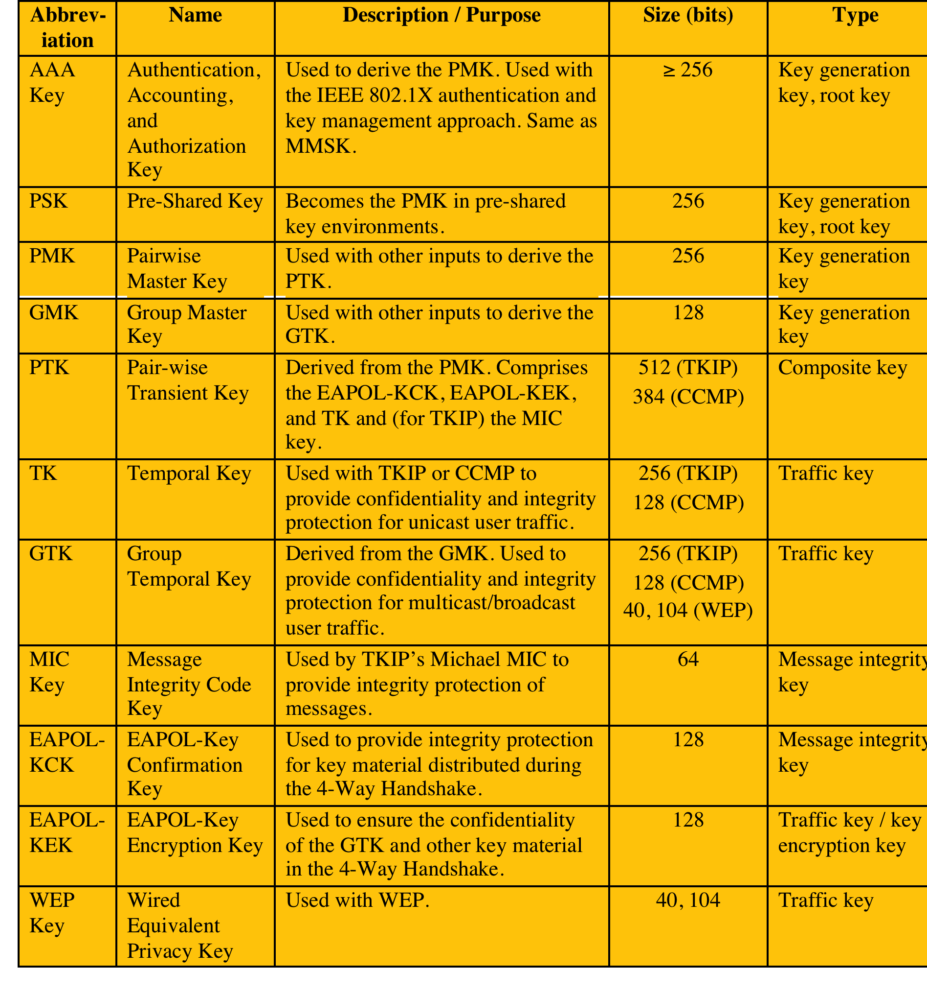
Table 24.3 IEEE 802.11i Keys for Data Confidentiality and Integrity Protocols
(Table can be found on page 757 in the textbook.)
Notes:
Pairwise keys are used for communication between a pair
of devices, typically between an STA and an AP. These keys form a hierarchy
beginning with a master key from which other keys are derived dynamically and
used for a limited period of time.
At the top level of the hierarchy are two possibilities. A pre-shared key (PSK)
is a secret key shared by the AP and a STA and installed in some fashion outside
the scope of IEEE 802.11i. The other alternative is the master session key (MSK) ,
also known as the AAAK, which is generated using the IEEE 802.1X protocol during
the authentication phase, as described previously. The actual method of key
generation depends on the details of the authentication protocol used. In either case
(PSK or MSK), there is a unique key shared by the AP with each STA with which
it communicates. All the other keys derived from this master key are also unique
between an AP and an STA. Thus, each STA, at any time, has one set of keys, as
depicted in the hierarchy of Figure 24.10a , while the AP has one set of such keys for
each of its STAs.
The pairwise master key (PMK) is derived from the master key. If a PSK is
used, then the PSK is used as the PMK; if a MSK is used, then the PMK is derived
from the MSK by truncation (if necessary). By the end of the authentication phase,
marked by the 802.1x EAP Success message ( Figure 24.8 ), both the AP and the
STA have a copy of their shared PMK.
The PMK is used to generate the pairwise transient key (PTK) , which in fact
consists of three keys to be used for communication between an STA and AP after
they have been mutually authenticated. To derive the PTK, the HMAC-SHA-1
function is applied to the PMK, the MAC addresses of the STA and AP, and nonces
generated when needed. Using the STA and AP addresses in the generation of the
PTK provides protection against session hijacking and impersonation; using nonces
provides additional random keying material.
The three parts of the PTK are as follows.
• EAP Over LAN (EAPOL) Key Confirmation Key (EAPOL-KCK): Supports
the integrity and data origin authenticity of STA-to-AP control frames during
operational setup of an RSN. It also performs an access control function:
proof-of-possession of the PMK. An entity that possesses the PMK is
authorized to use the link.
• EAPOL Key Encryption Key (EAPOL-KEK): Protects the confidentiality of
keys and other data during some RSN association procedures.
• Temporal Key (TK): Provides the actual protection for user traffic.
Group keys are used for multicast communication in which one STA
sends MPDUs to multiple STAs. At the top level of the group key hierarchy is the
group master key (GMK) . The GMK is a key-generating key used with other inputs
to derive the group temporal key (GTK) . Unlike the PTK, which is generated using
material from both AP and STA, the GTK is generated by the AP and transmitted
to its associated STAs. Exactly how this GTK is generated is undefined. IEEE
802.11i, however, requires that its value is computationally indistinguishable from
random. The GTK is distributed securely using the pairwise keys that are already
established. The GTK is changed every time a device leaves the network.

Slide 29
Notes:
The upper part of Figure 24.11 shows the MPDU
exchange for distributing pairwise keys. This exchange is known as the 4-way
handshake . The STA and AP use this handshake to confirm the existence of
the PMK, verify the selection of the cipher suite, and derive a fresh PTK for the
following data session. The four parts of the exchange are as follows.
• AP → STA: Message includes the MAC address of the AP and a nonce (Anonce)
• STA → AP: The STA generates its own nonce (Snonce) and uses both nonces
and both MAC addresses, plus the PMK, to generate a PTK. The STA then
sends a message containing its MAC address and Snonce, enabling the AP to
generate the same PTK. This message includes a message integrity code (MIC)
using HMAC-MD5 or HMAC-SHA-1-128. The key used with the MIC is KCK.
• AP → STA: The AP is now able to generate the PTK. The AP then sends a
message to the STA, containing the same information as in the first message,
but this time including a MIC.
• STA → AP: This is merely an acknowledgement message, again protected
by a MIC.
For group key distribution, the AP generates a GTK
and distributes it to each STA in a multicast group. The two-message exchange with
each STA consists of the following:
• AP → STA: This message includes the GTK, encrypted either with RC4 or
with AES. The key used for encryption is KEK. A MIC value is appended.
• STA → AP: The STA acknowledges receipt of the GTK. This message
includes a MIC value.

Slide 30
Temporal Key Integrity Protocol (TKIP)
Designed to require only software changes to devices that are implemented with the older wireless LAN security approach called WEP
Provides two services:
Message integrity
Adds a message integrity code to the 802.11 MAC frame after the data field
Data confidentiality
Provided by encrypting the MPDU
Notes:
IEEE 802.11i defines two schemes for protecting data transmitted in 802.11
MPDUs: the Temporal Key Integrity Protocol (TKIP) and the Counter Mode-CBC
MAC Protocol (CCMP).
TKIP is designed to require only software changes to devices that are
implemented with the older wireless LAN security approach called Wired
Equivalent Privacy (WEP). TKIP provides two services:
• Message integrity: TKIP adds a message integrity code to the 802.11 MAC
frame after the data field. The MIC is generated by an algorithm, called
Michael, that computes a 64-bit value using as input the source and destination
MAC address values and the data field, plus key material.
• Data confidentiality: Data confidentiality is provided by encrypting the
MPDU plus MIC value using RC4.
The 256-bit TK ( Figure 24.10 ) is employed as follows. Two 64-bit keys are
used with the Michael message digest algorithm to produce a message integrity
code. One key is used to protect STA-to-AP messages, and the other key is used to
protect AP-to-STA messages. The remaining 128 bits are truncated to generate the
RC4 key used to encrypt the transmitted data.
For additional protection, a monotonically increasing TKIP sequence counter
(TSC) is assigned to each frame. The TSC serves two purposes. First, the TSC is
included with each MPDU and is protected by the MIC to protect against replay attacks.
Second, the TSC is combined with the session TK to produce a dynamic encryption key
that changes with each transmitted MPDU, thus making cryptanalysis more difficult.

Slide 31
Counter Mode-CBC MAC Protocol (CCMP)
Intended for newer IEEE 802.11 devices that are equipped with the hardware to support this scheme
Provides two services:
Message integrity
Uses the cipher-block-chaining message authentication code (CBC-MAC)
Data confidentiality
Uses the CTR block cipher mode of operation with AES for encryption
Notes:
CCMP is intended for newer IEEE 802.11 devices that are equipped with
the hardware to support this scheme. As with TKIP, CCMP provides two services:
• Message integrity : CCMP uses the cipher-block-chaining message
authentication code (CBC-MAC), described in Chapter 12.
• Data confidentiality : CCMP uses the CTR block cipher mode of operation
with AES for encryption. CTR is described in Chapter 20.
The same 128-bit AES key is used for both integrity and confidentiality.
The scheme uses a 48-bit packet number to construct a nonce to prevent replay
attacks.

Slide 32
Notes:
At a number of places in the IEEE 802.11i scheme, a pseudorandom function
(PRF) is used. For example, it is used to generate nonces, to expand pairwise
keys, and to generate the GTK. Best security practice dictates that different
pseudorandom number streams be used for these different purposes. However, for
implementation efficiency we would like to rely on a single pseudorandom number
generator function.
The PRF is built on the use of HMAC-SHA-1 to generate a pseudorandom
bit stream. Recall that HMAC-SHA-1 takes a message (block of data) and a key of
length at least 160 bits and produces a 160-bit hash value. SHA-1 has the property that
the change of a single bit of the input produces a new hash value with no apparent
connection to the preceding hash value. This property is the basis for pseudorandom
number generation.
The IEEE 802.11i PRF takes four parameters as input and produces the desired
number of random bits. The function is of the form PRF(K , A , B , Len ), where
K = a secret key
A = a text string specific to the application (e.g., nonce generation or pairwise
key expansion)
B = some data specific to each case
Len = desired number of pseudorandom bits
For example, for the pairwise transient key for CCMP:
PTK = PRF(PMK, “Pairwise key expansion”, min(AP-Addr, STA-Addr)||
max (AP-Addr, STA-Addr)|| min(Anonce, Snonce)|| max(Anonce, Snonce), 384)
So, in this case, the parameters are
K = PMK
A = the text string “Pairwise key expansion”
B = a sequence of bytes formed by concatenating the two MAC addresses
and the two nonces
Len = 384 bits
Similarly, a nonce is generated by
Nonce = PRF(Random Number,"Init Counter", MAC || Time, 256)
Where Time is a measure of the network time known to the nonce generator.
The group temporal key is generated by:
GTK = PRF(GMK, "Group key expansion", MAC || Gnonce, 256)
Figure 24.12 illustrates the function PRF( K , A , B , Len ). The parameter
K serves as the key input to HMAC. The message input consists of four items
concatenated together: the parameter A , a byte with value 0, the parameter B ,
and a counter i . The counter is initialized to 0. The HMAC algorithm is run once,
producing a 160-bit hash value. If more bits are required, HMAC is run again with
the same inputs, except that i is incremented each time until the necessary number
of bits is generated. We can express the logic as
PRF(K, A, B, Len)
R ← null string
for i ← 0 to ((Len + 159)/160 – 1) do
R ← R||HMAC-SHA-1(K, A||0||B||i)
Return Truncate-to-Len(R, Len)

Slide 33
Summary
Wireless Security
Wireless network threats
Wireless security measures
Mobile device security
Security threats
Mobile device security strategy
IEEE 802.11 wireless LAN overview
The Wi-Fi alliance
IEEE 802 protocol
IEEE 802.11 network components and architectural model
IEEE 802.11 services
IEEE 802.11i wireless LAN security
IEEE 802.11i services
IEEE 802.11i phases of operation
Discovery phase
Authentication phase
Key management phase
Protected data transfer phase
The IEEE 802.11i pseudorandom function
Notes:
Chapter 24 summary.

